Slide 1
An Agile Way As an SET At LINE
-Product Ownership Edition-
Hiroyuki Ito

Slide 2

Objective
Explain
how to promote
your mission
with Agile
Notes:
The word “mission” includes “product planning”, “software development project”, and so on.

Slide 3
Another/Real Objective
Share
experience
in LINE Corp.

Slide 4
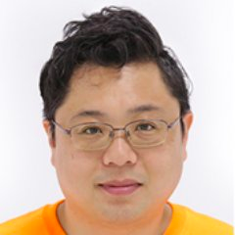


Hiroyuki Ito (The HIRO)
@hageyahhoo
The 1st SET at LINE Corp.
Speaker of RSGT2016/17
Speaker of Agile2014

Slide 5

Background

Slide 6

My Mission (2017/09-)
Found SET
and lead
Test Automation
at LINE Corp.

Slide 7

What is SET?
Software Engineer in Test
[Summary]
Test Automator
Tester and developer
Improve processes with (automated) test
from Wikipedia
Notes:
- From Google. - The same as ”Software Development Engineer in Test” (SDET) at Microsoft, Amazon, Apple, and so on.
- Google changed “SET” as “SETI” in 2016.
- Not QA who acts as the quality gate after development.
- Work with developers to enhance their productivity with automated test scripts.

Slide 8
Challenges
1. ? What should I do?
Confusion/disagreements about SET role
2. ? Details of products to test
I was a newbie at that time!
3. Needed stakeholders’ huge supports
To lead new activities smoothly as a newbie

Slide 9
Solutions
1. ? What should I do?
-> Discover needs
2. ? Details of products to test
-> Learn quickly from experiments
3. Needed stakeholders’ huge supports
-> Deliver values quickly/periodically

Slide 10
Agenda
1. Discover Needs
2. Learn Quickly from Experiments
3. Deliver Values Quickly/Periodically
4. What to Do Next
5. Conclusion

Slide 11
1. Discover Needs
2. Learn Quickly from Experiments
3. Deliver Values Quickly/Periodically
4. What to Do Next
5. Conclusion

Slide 12

First Challenge
Confusion/disagreements
about SET
among stakeholders
No shared understanding
No verbalized needs/problems
No leaders to solve them

Slide 13
Solutions
Share understanding by discovering/verbalizing needs
Establish proposals/milestones to solve above needs
Iterative consensus on above ones with managers/executive
Re-examine solutions/milestones constantly/iteratively

Slide 14

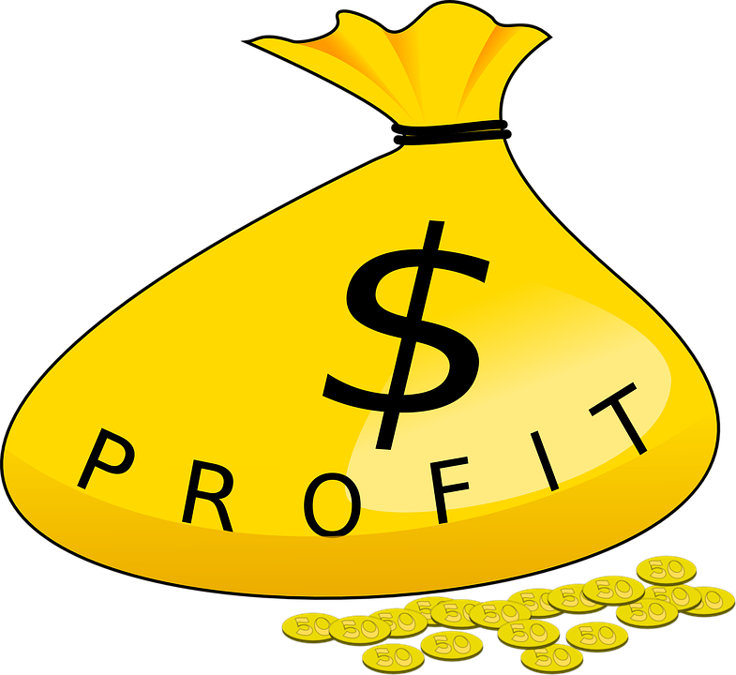

“3 KPIs” as Criteria
Sales
Profit
Employee
Satisfaction

Slide 15
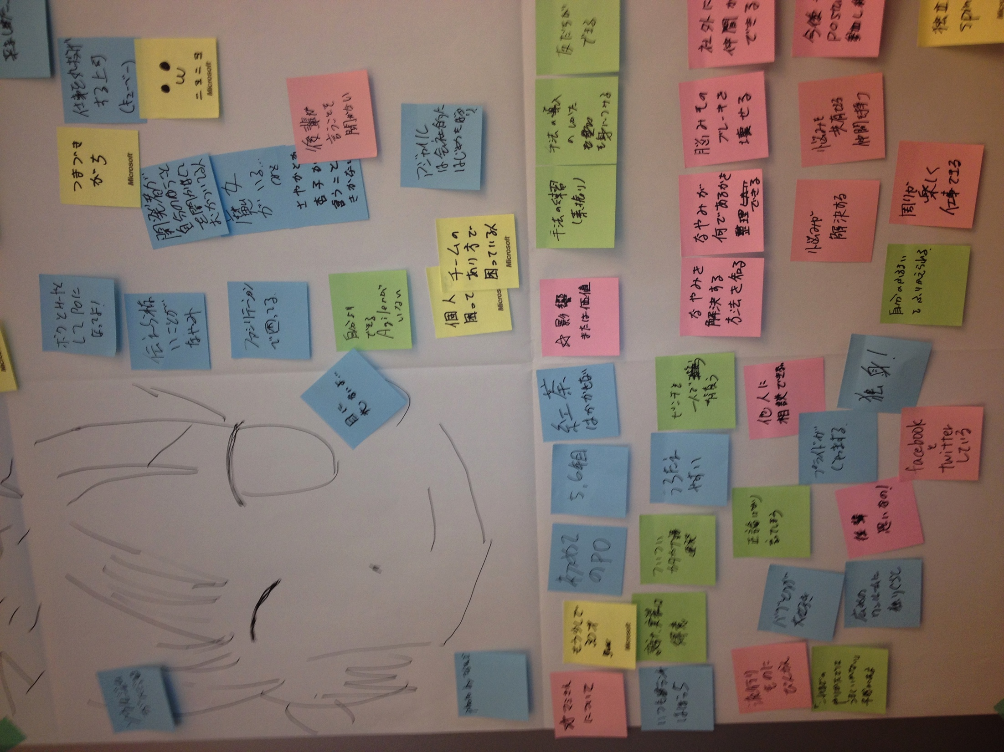
Agile Way
Product Discovery
Discovering/refining solutions
by iterative hypothesis and test cycle
Persona
User Interview
User Story Mapping
MVP
KPI

Slide 16
1. Discover/Verbalize Needs
Analyze target products to test
Analyze outage reports
Talk to stakeholders directly

Slide 17


1) Analyze Target Products
Visualize by Continuous Integration
and Static Code Analysis:
Code coverage
The amount of technical debts
Priority to improve

Slide 18
2) Analyze Outage Reports
Reports == Treasure-trove
We can know
products which outages often occur
causes of outages
impact on sales/profit
how to reduce outage and MTTR

Slide 19
3) Talk to Stakeholders
Troubles == Src of Ideas
They may have troubles but not verbalized.
If we verbalize their troubles, they will follow us.
Direct and honest conversation is good to know troubles deeply.

Slide 20
2. Establish Proposals
Decide target products based on
frequency of outages
impact on sales/profit
Aim to make failure detection faster and reduce MTTR
Utilize Test Automation
Work with developers and QA
Provide knowledge and mechanism to lead developer-testing

Slide 21
3. Iterative Consensus
Propose ideas and get feedback weekly
Discover proper solutions gradually
Achieve a consensus on solutions step-by-step
Re-examine solutions constantly

Slide 22
Summary
Discover/verbalize needs
Share understanding based on 3 KPIs
Iterative consensus/re-examination on solutions/milestones with stakeholders

Slide 23
1. Discover Needs
2. Learn Quickly from Experiments
3. Deliver Values Quickly/Periodically
4. What to Do Next
5. Conclusion

Slide 24
Next Challenge
Discovered needs
(Why & What)
How should we achieve? (How)

Slide 25
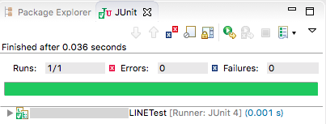
Solution
Learn target products by utilizing Test Automation
*Example

Slide 26
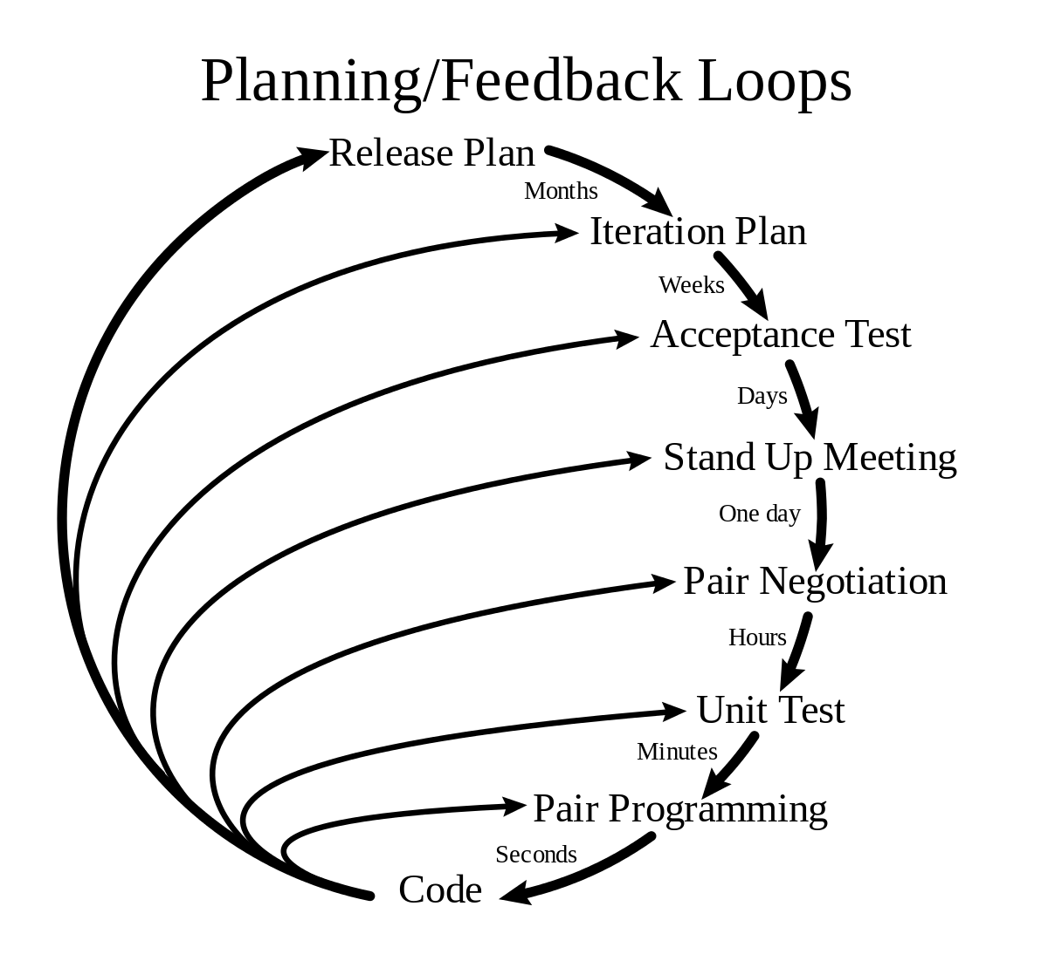
Agile Way
eXtreme Programming (XP)
Built mechanism to learn products very quickly

Slide 27
1. Run Products to Know
“Tests should help us
understand the SUT.”
（XUnit Test Patterns）
Run test scripts where you want to know
Running products/features is a best way to learn
Current behavior is the truth

Slide 28
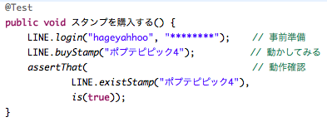
2. Easy to Run
xUnit tools are very common globally
and easy to understand
*Example

Slide 29
3. Good for Trial and Error
“Do Not Harm”
（XUnit Test Patterns）
Test does not harm products if you write test scripts properly
You can fail a lot with safe
You can try a lot

Slide 30
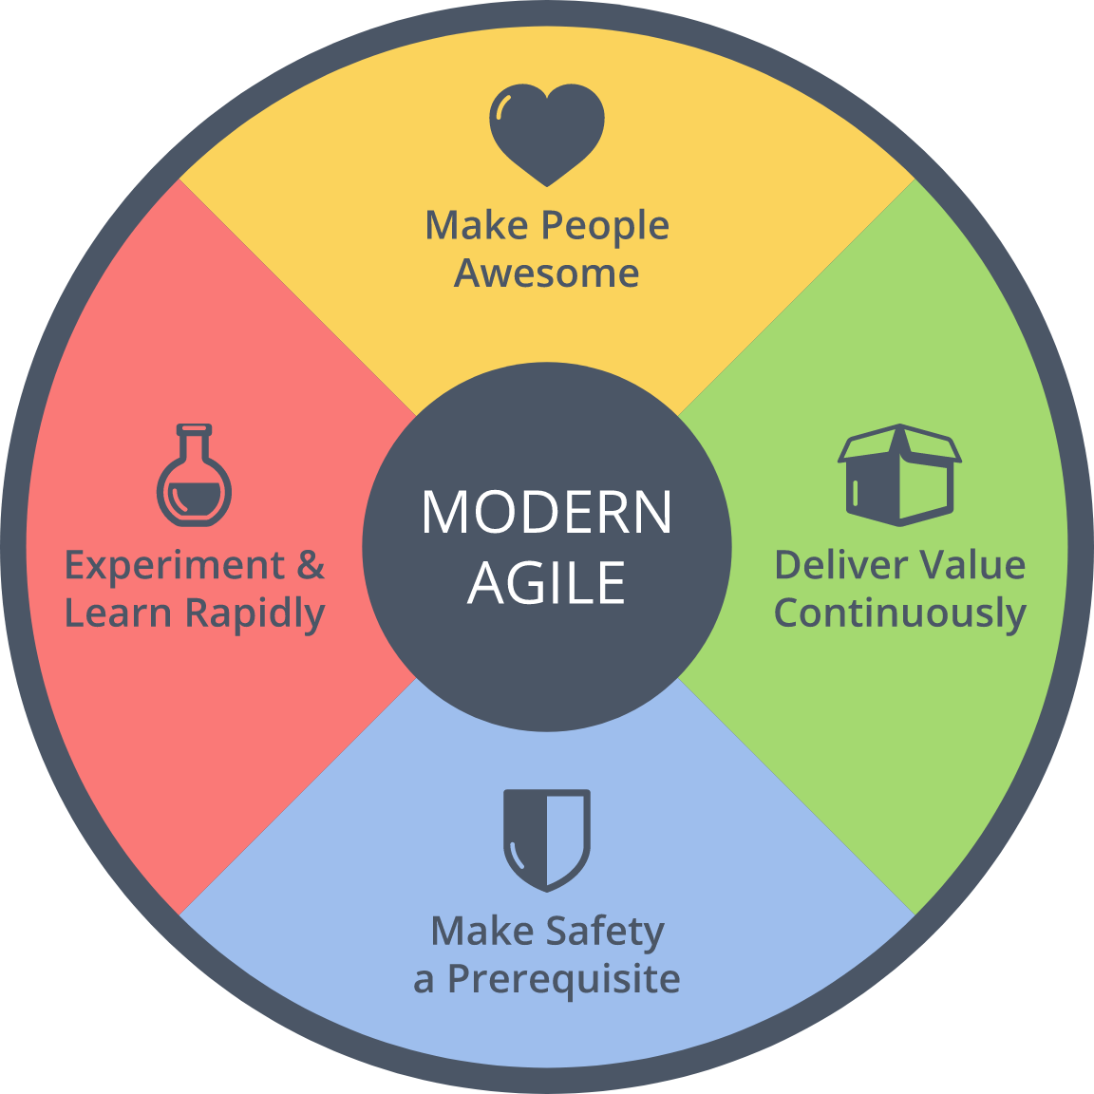
== Psychological Safety
from Modern Agile

Slide 31

Result
Achieved a consensus
on SET activities
with managers/executive
based on test scripts
within 45 days!

Slide 32
1. Discover Needs
2. Learn Quickly from Experiments
3. Deliver Values Quickly/Periodically
4. What to Do Next
5. Conclusion

Slide 33

Next Challenge
関係者と幅広く 協力関係を作りたい

Slide 34



Solution
Deliver
(executable) deliverables
weekly

Slide 35
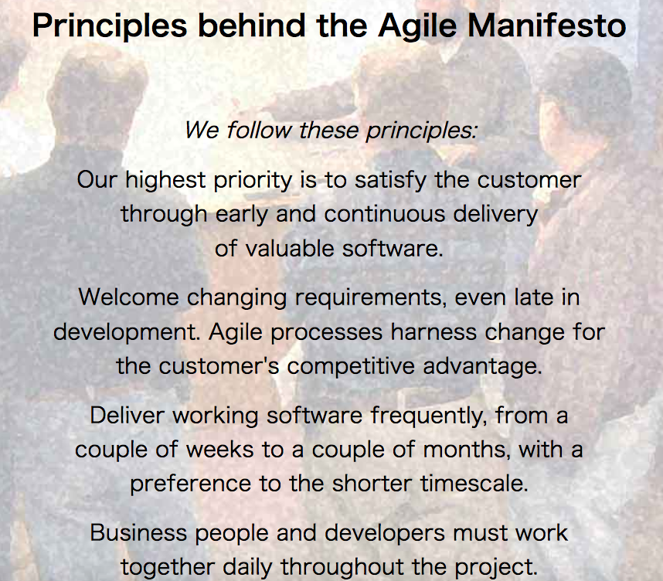
Agile Way
http://agilemanifesto.org/principles.html

Slide 36
Values Delivered (1)
1週目 | テストスクリプトを活用し、 プロダクトの課題を発見・提示。
2週目 | SETのゴール・施策案の初版を 役員・マネージャー陣へ提示。
3週目 | プロダクトの静的コード解析結果を提示。 合わせて、定期的に報告する仕組みを構築。
4週目 | 静的コード解析など、導入した施策の 実装方法をデベロッパーへ共有。
5週目 | SETの施策のマイルストーン案を 役員・マネージャー陣へ提示。

Slide 37
Values Delivered (2)
6週目 | SETの施策のマイルストーン案について 役員・マネージャー陣と合意。
7週目 | 世界各拠点に散在していた テストの情報・ツールを1箇所に集約。
8週目 | 障害が多発していたプロダクトに、 自動テストによる障害検知の仕組みを実装。
9週目 | QAとデベロッパーとをつなぎ、 ゴールと施策を共有する定例会を開始。
10週目 | デベロッパーからのテストに関する相談が 急増し、１つ１つ対応。

Slide 38
Utilize “3 KPIs”
Sales and Profit
SETとしての施策・活動は、 全てこれらの向上・改善と関連づけている。
Employee Satisfaction
Executives/Managers/QA
不安の発見・言語化とそれらへの共感
数値的効果とスケジュール感の明示
Developers/QA
技術的な知識欲の刺激→イノベーション

Slide 39
Make Big Impacts
“Managing impact for a team of TEs and SETs is the job of the TEM.”
（How Google Tests Software）

Slide 40
Result
施策を支持してくれる
関係者の増加と
SETの認知度の向上
Product Team
QA/Test Automators
Product Manager

Slide 41
1. Discover Needs
2. Learn Quickly from Experiments
3. Deliver Values Quickly/Periodically
4. What to Do Next
5. Conclusion

Slide 42
1. Create Slack Time
Many persons are reluctant to improve their work due to lack of slack time
Create slack time with automation technique
Provide hints for innovation

Slide 43
2. Find/Train Next SETs
There are few engineers
who has business perspective
and Test Automation skills
Find and train next SETs

Slide 44
3. Sum up Knowledge
Knowledge and experiences are accumulating gradually
Sum up them as practices is good to proceed SET activities
Sum up them as Patterns will be useful as common language

Slide 45
1. Discover Needs
2. Learn Quickly from Experiments
3. Deliver Values Quickly/Periodically
4. What to Do Next
5. Conclusion

Slide 46

Summary
To know your target is always the starting point
You need supporters to proceed actions
You can utilize Agile practices for above things

Slide 47
“3 KPIs” as Criteria
Sales
Profit
Employee
Satisfaction

Slide 48
My Mission (2017/09-)
Found SET
and lead
Test Automation
at LINE Corp.

Slide 49

My Answer
Contribute to
our business
with
Test Automation!

Slide 50

Conclusion
Let’s
contribute to
the business
with Agile!

